Slide 1
MIGRATE TO THE
NEW PROJECTS
Notes:
Welcome to the webinar Projects in Teamleader Focus: from old to new.
Today we are looking at the bigger picture. You are attending this webinar because you are users of the old project module that may already or very soon migrate to the new module. The content to ensure a smooth start in the new projects is there, but first let's take a look at how we got there and where we currently stand.
Why this webinar? We want to get you excited about migration and show you that it pays to transition as soon as possible. To make that data migration go smoothly, I'm going to guide you through it the next half-hour.

Slide 2
Migrate to the new projects
CONTENT WEBINAR
01
02
CURRENT SITUATION
Development and status of the new project module
MIGRATION
What exactly is the migration flow like?
03
04
OLD VS NEW
What are the improved and new features?
CHECKLIST
Prepare yourself and your team for a smooth migration
Notes:
What are we going to talk about this session? The four major topics of this webinar are:
The current situation
The migration
The comparison between the old and new projects
The checklist to guide you through the migration
There's a lot to say about that, so we'll get right into it. Before we do, let's quickly go over the house rules so that everything goes smoothly.

Slide 3
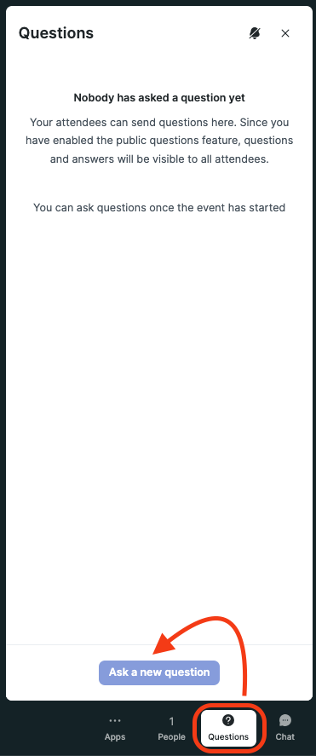

QUESTIONS?
QUESTIONS TAB
Notes:
During the session, you can ask your questions. You do that through the Questions tab. It is important to do so there, so that my colleagues who will answer your question can keep a good overview of what has already been answered.
All questions can be asked, but specific questions about your personal Teamleader Focus account can obviously not be answered here. A lot of information will be covered, so please absorb it and let us know if something is not clear.
May I ask you to ask lots of questions? There will be plenty of time after the presentation for the live Q&A. Today, I would especially like to give you a chance in this webinar to ask your questions so that we can clear all doubts.

Slide 4
CURRENT SITUATION
Migrate to the new projects
Notes:
Then we are ready to begin. And we will first talk about the state of play. This is, on the one hand, a motivation why we are designing a new module and, on the other hand, an insight into where we currently stand migration-wise.
How this state of affairs sits in terms of functionalities will be discussed later. Then we will look at what new functionalities there are and why that is relevant for migration.

Slide 5
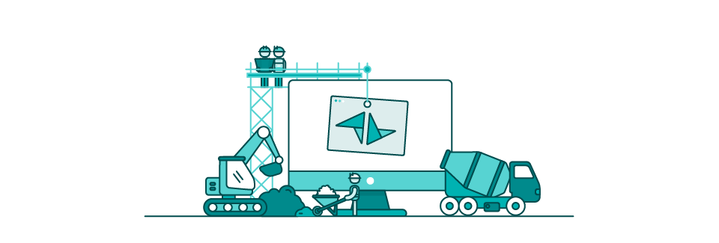
CURRENT SITUATION
Development
COMPLETE OVERHAUL
Smoother management
Enhanced flexibility
Define your workflow
🎯A project management tool adapted to the user's way of working, not the other way around.
Notes:
The new Project module is designed to help you better manage your projects. This required a complete overhaul of the old module, with one clear goal: to create a project management tool that adapts to the user's way of working and not the other way around. A code word in development was flexibility. The previous module was quite robust, following a set pattern, but with the new projects, you determine your own workflow.
This revision of the module also means that your original way of working is going to undergo a change. That's why we insist on training and, above all, briefing your employees on the new module before the transition. There is a lot of free content available that is going to help you do this. After watching a few videos, you'll have a complete understanding of how it works.

Slide 6

CURRENT SITUATION
MIGRATION
From old to new projects
Migration batches
Migration flow
🫵 You can migrate (soon).
Notes:
That said, we can move on to where we are now with the new projects. A migration is underway, which means we are transferring users from the old module. To make that transition as smooth as possible for everyone, we are working with migration batches, which are groups we migrate.
You may already see the migration flow in your account. You may also be following this webinar, but not yet see this in your account. Don't worry, it's your turn soon. If you are not yet included in a migration batch, the reason is simple: a functionality you currently use in the old projects is not (yet) developed in the new projects, so we cannot guarantee data transfer. As soon as this is possible, you will be eligible for migration.
How do you know if migration flow is active in your account? I'm going to show you that now.

Slide 7
MIGRATION
Migrate to the new projects
Notes:
Migration. That's what we're going to talk about now.
If you received this the invitation to this webinar in your mailbox, I have good news: you can migrate right now or be able to migrate, starting from next week. The driving force behind this is a certain feature, but more on that later.
What is the main purpose of this webinar? To give an insight into the migration flow and provide valuable tips so that you or your team do not face any surprises. This is a positive but big change. Now change management needs care, hence this webinar.

Slide 8
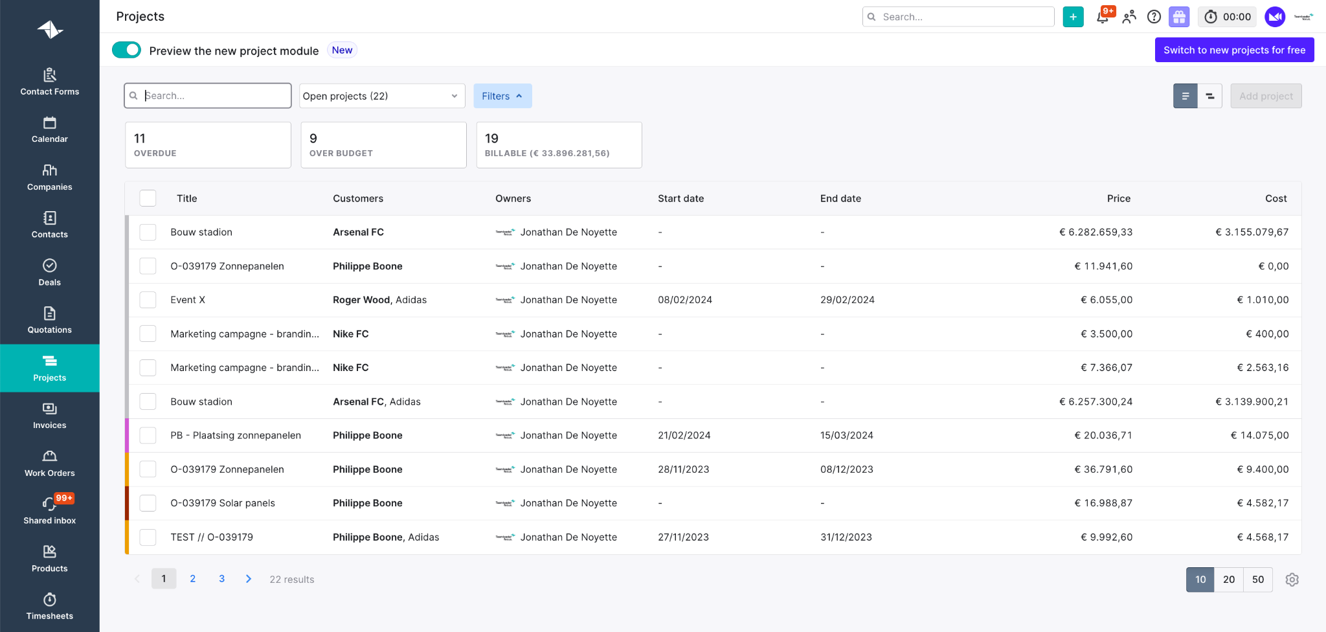
MIGRATION
MIGRATION FLOW
Slider for preview
Visualisation projects
Only admins can migrate
☝️ Migration is irreversible
🗣️ Internal communication is key
Notes:
If you are in the migration flow, you will see a slider at the top left that allows you to preview your projects in the new view. If you click this, you are not migrating yet. You can perform some actions in preview mode, but the main goal is to visualise your existing projects. Migrating to the new project module cannot be undone.
Only admins can Migrate to the new projects. So it is very important to inform your team about the migration. Non-admins are not going to see the flow and thus not be informed. So clear internal communication is not to be underestimated here. We have created many resources such as training videos and articles to get your team well underway.

Slide 9
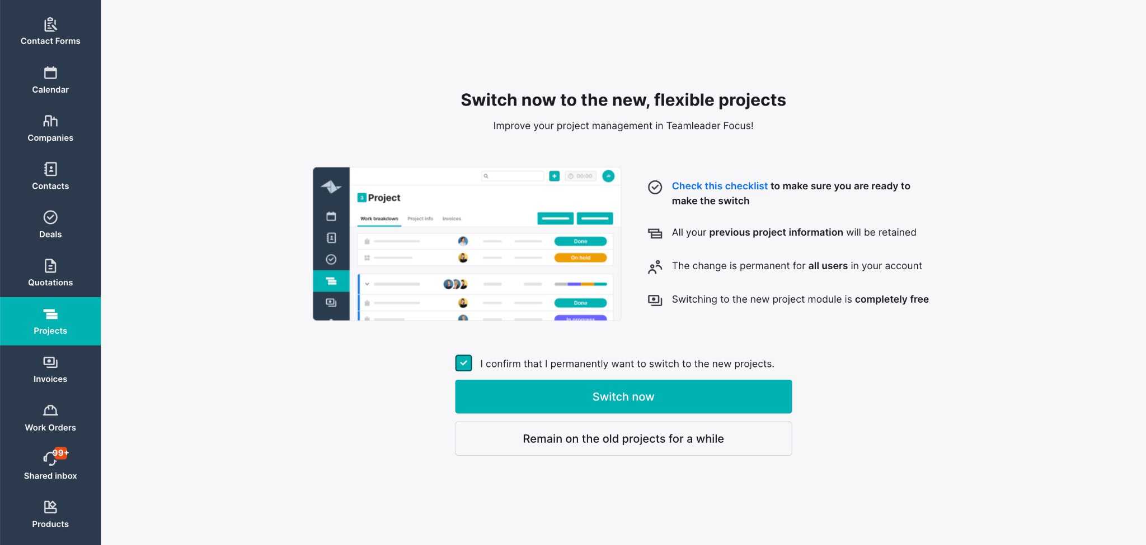
MIGRATION
Notes:
If you click ‘Switch now’ at the top right, you will see this screen where you need to finalise the migration. We have just covered most of the info you see here. But I like to emphasise again that your previous project information is retained. Why do we work with these migration batches? To ensure a migration without data loss. If you qualify for migration now, it means that the functionalities you used in the old projects are now also available in the new ones.
What if you are still in doubt? Then be sure to check out our checklist. You can simply click through to our checklist in our support centre via the link we added there. We will talk about that checklist later. But first, about the functionalities.

Slide 10
OLD VS NEW
Migrate to the new projects
Notes:
A migration obviously implies a transition from old to new. New can be a bit scary, but finally usually turns out to be better.Here, you can leave out ‘usually’, because I can guarantee that is the case here. The new project module is simply better. Let's dive in.

Slide 11
COMPARISON
Migrate to the new projects
OVERVIEW MODULES
Projects overview | Project timeline | Project info | Work Breakdown
Tasks | Materials | Billing method | Time tracking
Link to quotations | Link to invoice | General | Settings
Support article: Old projects vs new projects
Webinar: Projects: out with the old, in with the new
Notes:
Last webinar on project migration, we did a comprehensive comparison of all these modules. We're not fans of duplication at Teamleader, so we're not going to repeat this as the recording and support article are already there for you.
What we will do, however, is review the latest features since the previous webinar given on Tuesday 2 April 2024. This is also going to immediately make the migration flow a lot clearer.

Slide 12
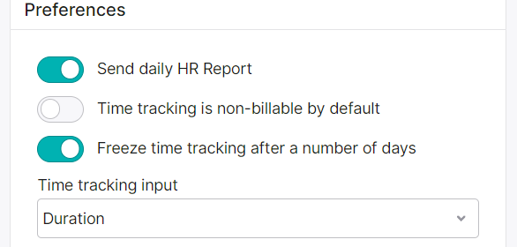
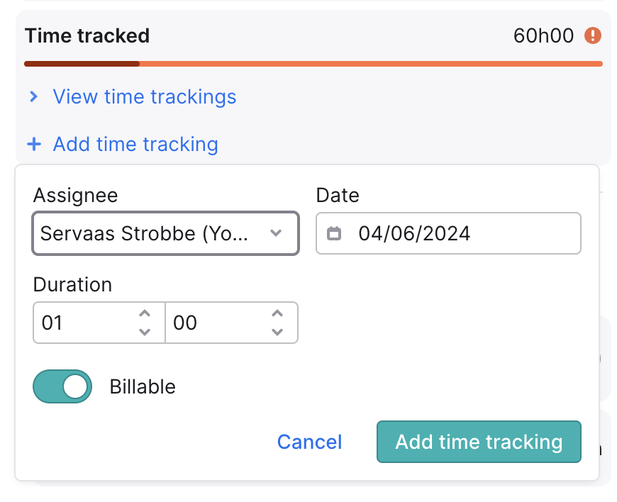
TIME TRACKING ON DURATION
Notes:
Time tracking based on duration is now possible in the new projects.
There is a dropdown to switch between the default start and end time or duration recording in the settings under Time recording. This duration registration also works on the task side panel of projects.
It is important to note that this time registration entry setting applies to the entire account, meaning that every user in the account will register time registration based on duration.

Slide 13
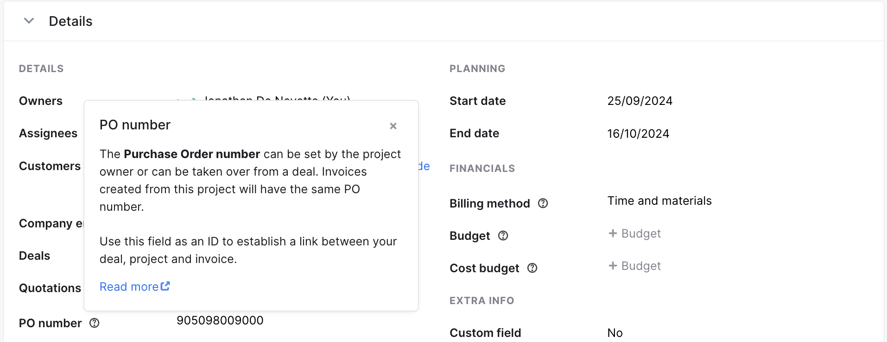
PO NUMMER
Notes:
A PO number field has been added to new Projects.
This is useful to have an overlapping ID for deals, projects and invoices, as this PO can be carried over from deals.
What else is nice about it? The PO number is also added to invoices created from a project.
Here, we see the PO number in the Project Info tab, but it can also be added to the project header. Later will also come the ability to view and search the PO number in the projects overview.

Slide 14
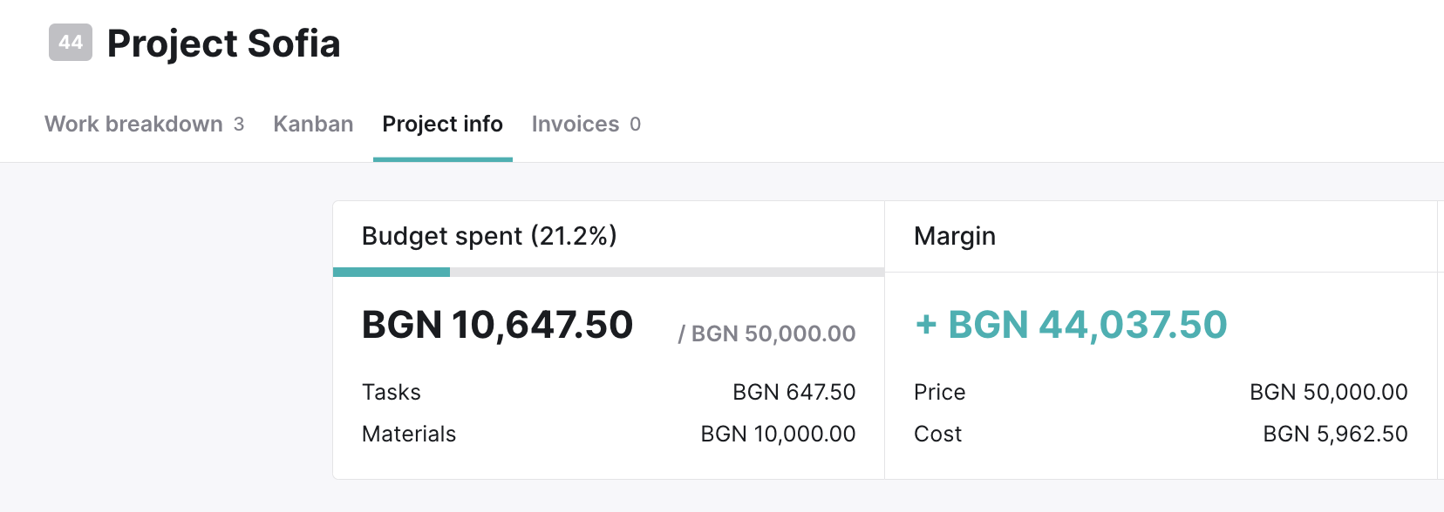
CURRENCIES
Notes:
Projects now support all currencies, not just EUR.
This can be adopted from the currency of the entire account, quote or corporate billing preferences.
It certainly opens up opportunities for new projects for international leads and existing international customers on the migration list.

Slide 15
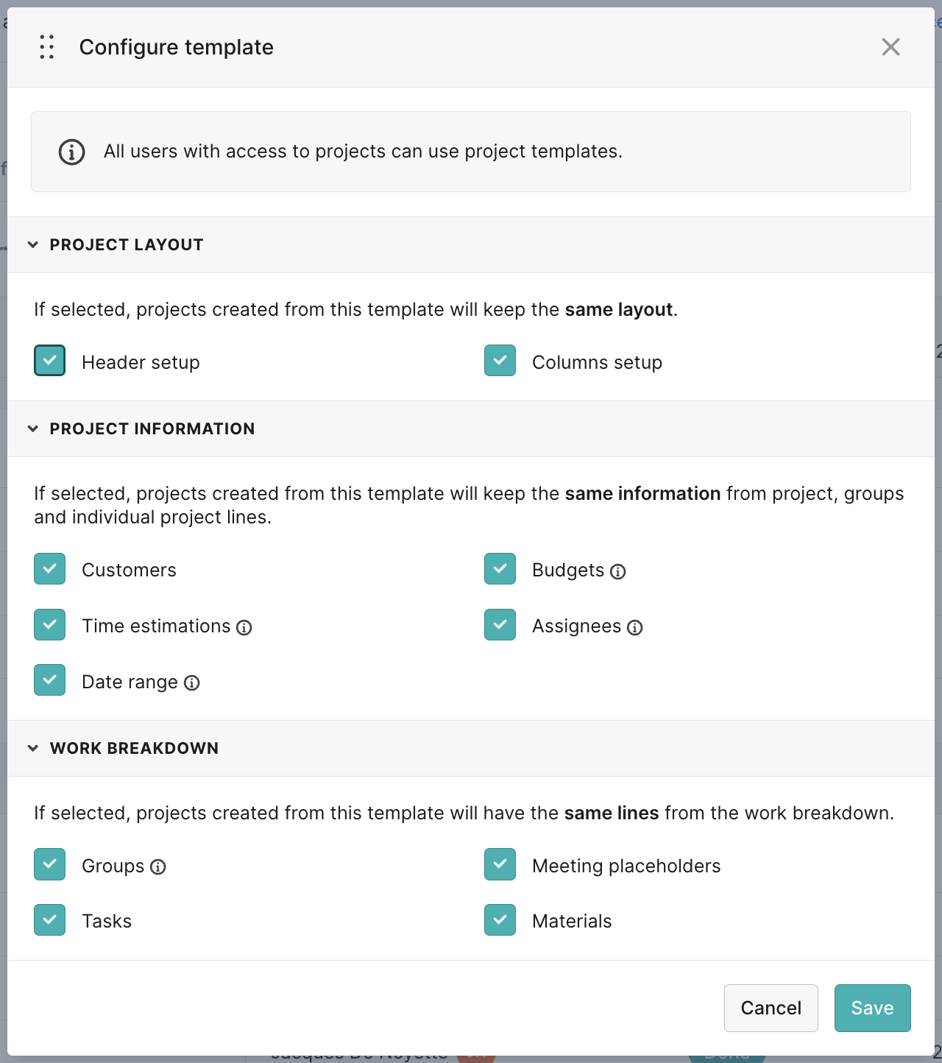
TEMPLATES
Notes:
Project templates, the most used and until recently missing feature of the old module, is now available in New Projects. More powerful than ever before!
Create templates from scratch or mark existing projects as templates. For each template, specify what should be replicated in projects created based on the template.
The layout of the project.
The information associated with the project.
The type of project rules (now also including placeholders for meetings!).
And when updating a project's budget, you now get the option to update the underlying budgets proportionally as well, so you can keep the same distribution of budgets.

Slide 16
MIGRATION FLOW
WHEN IS THIS VISIBLE?
✅ All essential functionalities available
✅ Smooth and complete migration possible
✅ No data loss during transition
If the migration flow is available in your account, you can safely switch.
Notes:
So what does this tell us? The developed functionalities go hand in hand with the migration flow. Because we offer this migration flow only when we can ensure a smooth and complete migration.
For that, functionalities need to be developed. An excellent example is the project templates we just saw.
The development of that functionality ensures that the next batch can migrate soon. If you do not currently see the project flow in your account, but you were invited to this webinar; then you can assume that you are in this batch.
So you can conclude that if the migration flow is available in your account, you can safely switch. With no data loss on transition. Because we won't let you migrate until you have all the functionalities that you were also using in the old module.

Slide 17
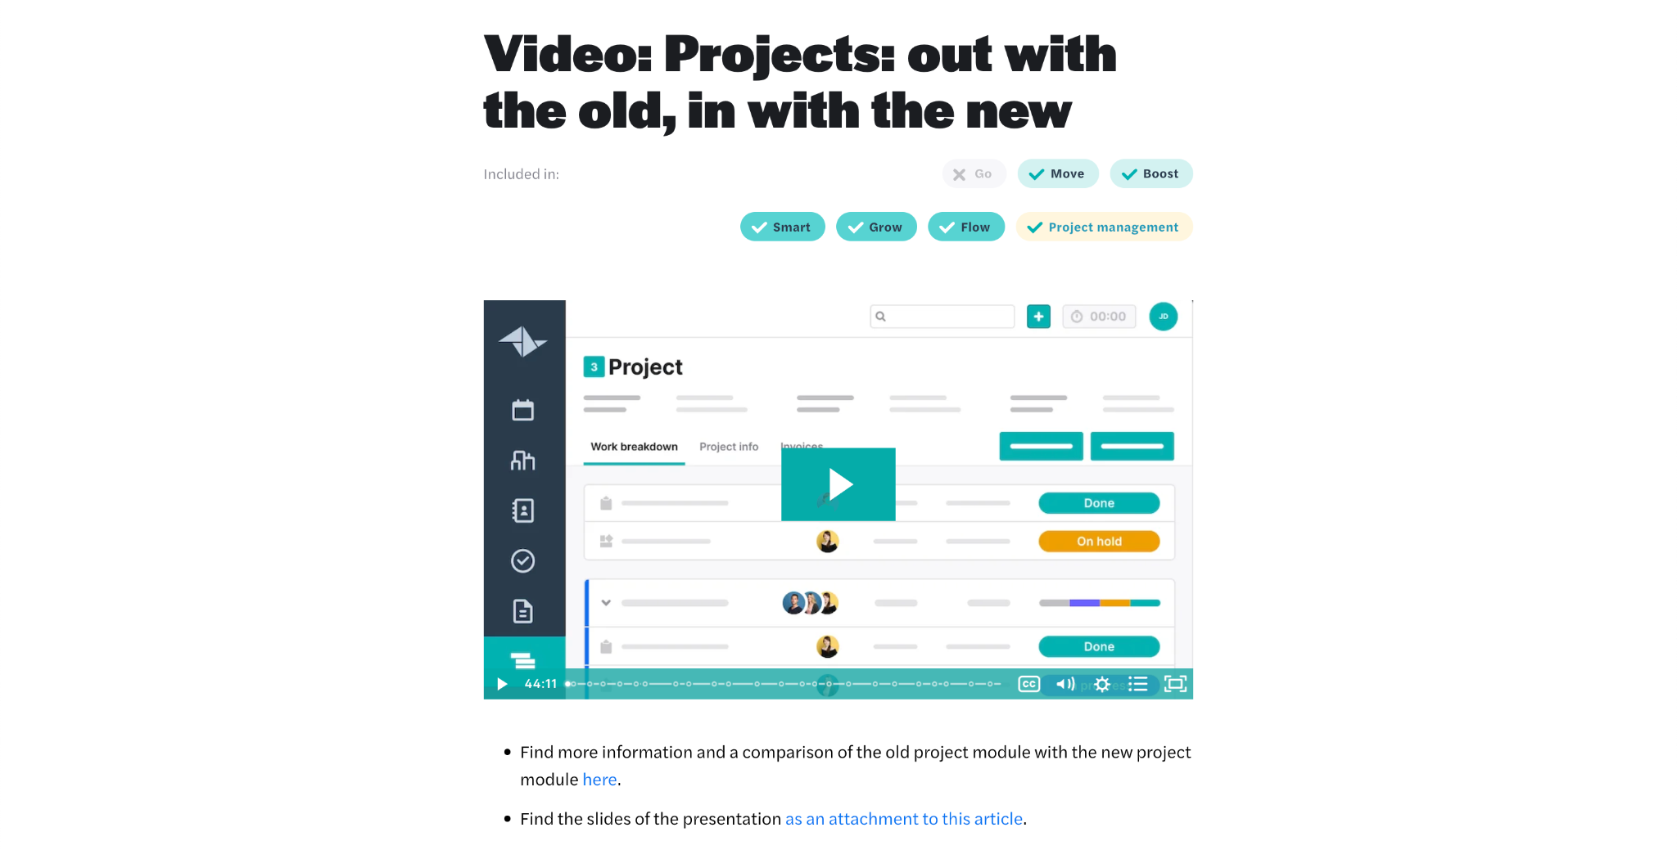
COMPARISON
Want to know more about the differences between old and new projects?
Support Centre > Training videos > Projects
Notes:
Want to know more about the improvements of the new compared to the old projects? Then be sure to check out the previous webinar. Available in our support centre at project training videos.

Slide 18
CHECKLIST
Migrate to the new projects
Notes:
Because we are going to talk about the tool you already saw a moment ago on the migration page, when you click that you want to pass for migration.
This checklist is a tool to help you and your colleagues get to know the new projects. So it certainly does not serve to deter you, but rather to make you aware that you are switching to a new module.
Change is always something exciting or even scary, but in that we want to guide you as best we can with this checklist. And also with this webinar, because I'm going to break down the checklist for you.

Slide 19
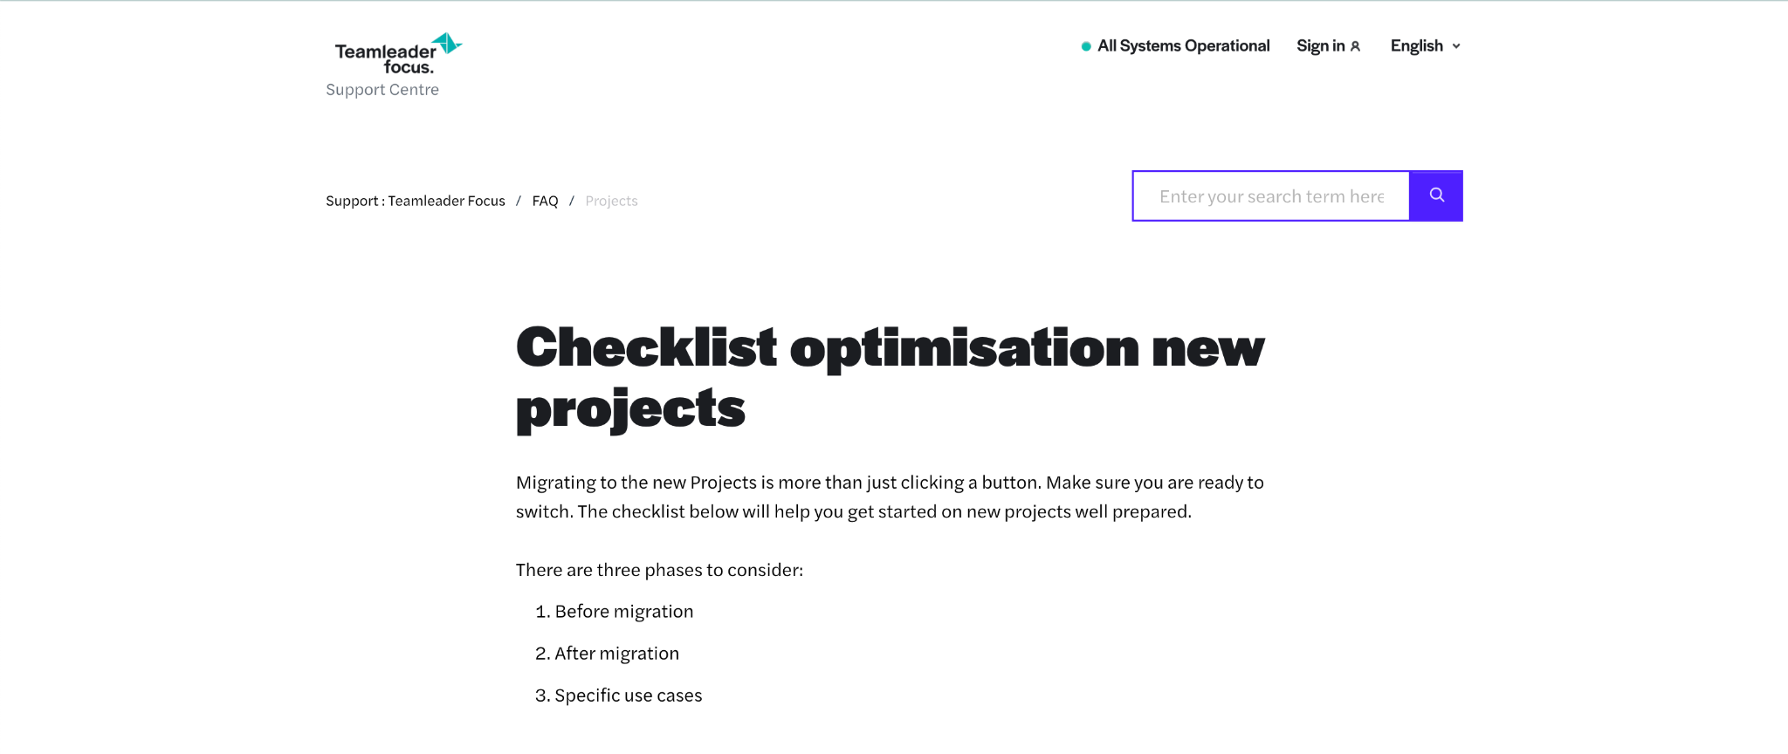
CHECKLIST
Notes:
So on our support centre and via the link on the migration page, you will find the checklist for an optimal transition to the new projects. We divide this ourselves into two major parts:
The pre-migration aspect
And the post-migration part
On top of that, we share specific use cases, based on previous customer experiences. A kind of trouble shooting, in other words. This section is supplemented and certainly does not apply to every project user.
I therefore like to focus on the phases before and after migration.

Slide 20
CHECKLIST
BEFORE MIGRATION - GENERAL
Check internal processes / current flow: how do you use projects now?
  Evaluate your workflow: how do you use projects for quotations and invoices?
  Create a sample project according to your ideal scenario.
  Make sure your active projects are up-to-date.
  Create an external test account.
Notes:
Workflow: what are the internal processes? How do you use projects? Quotations, for example: do you work with those and, if so, how? Can you transfer the content of your quotations one-to-one? If so, feel free to take quotations as a starting point and convert them into a project. That will then be your workflow.
Would you rather start from a project? Then choose sample projects that you can easily duplicate or make use of our latest functionality: project templates.
Can't close your projects because they are still ongoing? No problem but make sure they are up-to-date. We also touched on this at the beginning of the webinar: visualise your old projects in the new project module and process those open time entries or invoices.
Sample projects: What do we mean by them? In your old project module, create an ‘ideal world’ project. Once you've finished that, you can visualise in the migration flow what that would look like in the new projects by turning on the slider. That doesn't mean you're migrating yet, but this way you can already see what your ideal old project would look like in a new look. Because you yourself have put all the information in your old project, you will see one-to-one how it will look in the new project module.
Up-to-date: So when you switch over, make sure your active projects are up to date before you migrate. Close the finished projects, invoice as much as possible, ... just work through as much as possible. Of course, this is purely a tip, because if you qualify for migration, it means we can safely transfer all your data (completed or not).
External test account: in the checklist on our support centre, in the general section you will also see the option to create a test account. This is an external environment - i.e. not within your account - where you can try out the new module without any worries. Such an account is active for a fortnight by default.
I am convinced that this is going to help you feel confident about a transition. You didn't learn cycling based on theory either, you have to start doing it yourself.
Are you then ready to move to the new project module? No. *NEXT SLIDE*

Slide 21
CHECKLIST
BEFORE MIGRATION - GENERAL
Train your colleagues
  Videos and articles about the operation at our Support Centre.
  Communicate when the new operation will take effect.
  Document your new process
  Tip: appoint (a number of) migration coach(s) internally.
💡 New module = new opportunities.
Notes:
Train your colleagues: before pushing the migration button, you should inform your team. So the slider will appear in your account when it is ready for migration, but not in the account of your team members without admin status.
Before you push them to the new projects, it is important that you inform them of this change. So communicating when the new operation will take effect is essential. And just notifying them also seems insufficient to me personally.
After all, you want your colleagues to be able to start working immediately, don't you? We have a lot of training resources available for that:
Old projects vs new projects
How To: Add a project in Teamleader Focus
Video: Projects in Teamleader Focus
FAQ projects
Training videos
Do you have to make your team go through every video or article? No. You would do well to document your new process. It doesn't have to be much, just a guide of how you want to deploy projects now.
One tip we like to give in this regard is to engage a migration coach, especially for larger companies. That is a person who collects questions within your organisation and answers them.
Above all, see this as an opportunity. A new module offers new opportunities. There are more possibilities so you can realise your ideal workflow.
And suppose you would like some help with this or you want to take a closer look at that ideal workflow? Then you can always purchase a one-hour session via your licence page to spar about this with someone from our onboarding team.

Slide 22
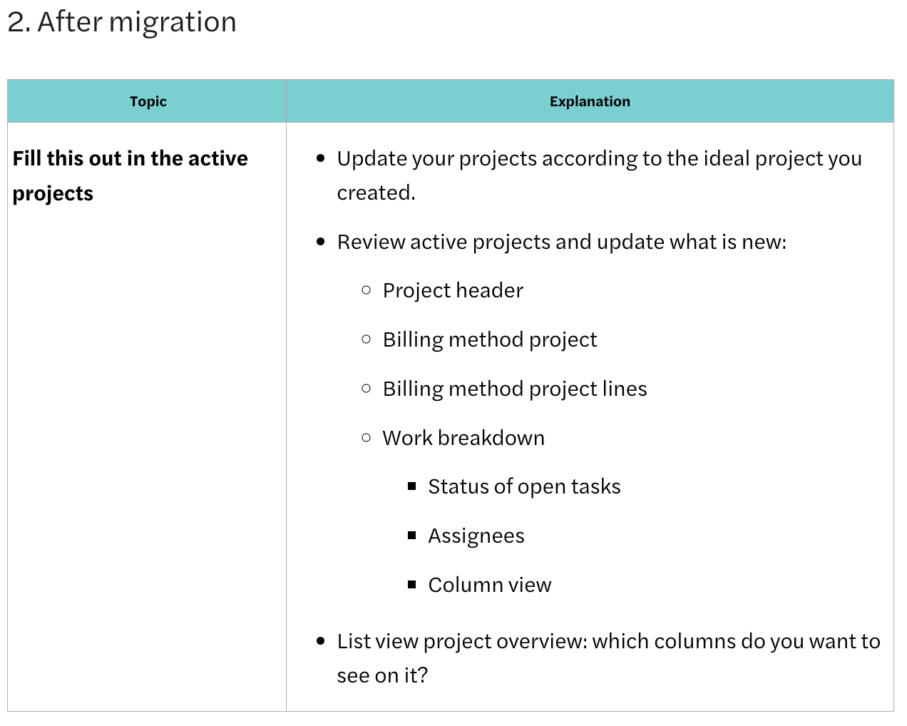
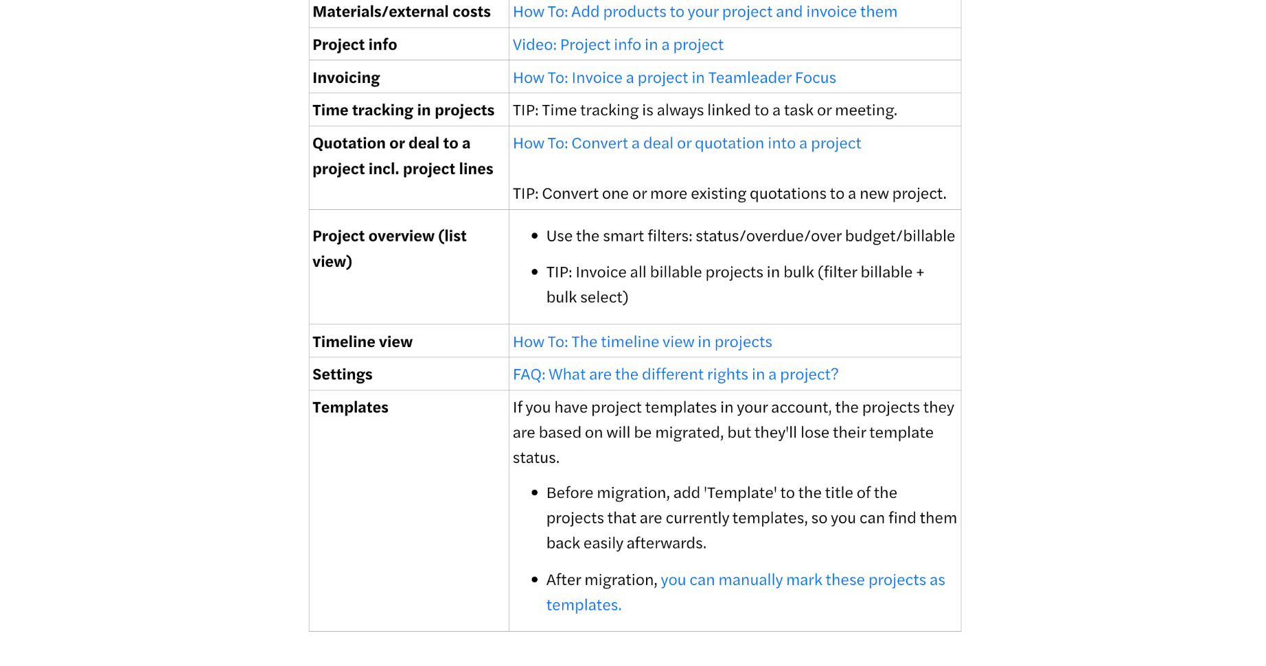
CHECKLIST
BEFORE MIGRATION - FEATURES & TABS
Notes:
What else do you see in the checklist at the particle for migration? All kinds of information about the different modules and functionalities within your project or strongly related to it, such as offers we just talked about.
This fits into the section on testing that we mentioned. In each section, you will find relevant videos, articles and tips that will help you better understand the underlying behaviour of each functionality.
You can also see that on this print screen from our support centre. There are different types of functionalities that you already know from the old project module and what has changed there, for example, in the new project module or how to get started with it. For example:
In the project overview, you now have smart filters available to you
As a tip, we also give you the option to invoice projects in bulk from your overview. This is a new, handy feature that will save you time.
So it's definitely worth going through that checklist before migration. Then you'll be sure you're ready to migrate and then also...

Slide 23
CHECKLIST
AFTER MIGRATION - UPDATE ACTIVE PROJECTS
Notes:
Use the post-migration checklist. That one is smaller, because most of the work is always in the preparation, of course. Still, it is important to add to your active projects after migration.
Remember that ideal project you created before you migrated? Your active projects - those are your projects from the old module that you will still be working in - you want to make them look like that.
So if you paid attention to creating such an ideal project in preview mode. Then updating what's new will be a piece of cake. Below are the things that have changed/improved and where you will want to make edits:
Project header: which is new and completely customisable to your needs. Good to know is that new projects take over the same header (and column configuration) from your most recent project.
Invoicing methods: per project, you have three general invoicing methods (fixed price, time & materials and non-invoiceable), but you can set a specific invoicing method per project line; for tasks, you have a choice of five methods.
Work overview: this looks completely different and is a lot more flexible. Embrace that flexibility and easy customisability. You can set your column view the way you want and easily assign status and multiple employees to project lines such as tasks.
In the list view - that's your project overview where you see all your projects - you can also filter based on deadline, budget and billability.

Slide 24
CHECKLIST
ADDITIONAL PREPARATION - SPECIFIC USE CASES
Timesheets
  Timesheets are now always linked to a task.
Advance invoices
  Invoicing based on % is done with the Fixed price invoicing method.
Tickets
  You no longer link these to a project, but to a task.
💌 Found a relevant use case yourself? Let us know.
Notes:
With these two aspects: a thorough preparation before migration and a check-up after migration, you are actually completely ready. The importance lies mainly in the preparation and that's where extra info never hurts. That is why we also have some specific use cases.
There we have relevant information for project users who:
Add loose time trackings to existing projects, because from now on you should always link that to a task
Make advance invoices, you now do with the fixed price invoicing method. Then you can invoice based on %.
You can no longer link tickets to a project, but you can easily link the task you create from your ticket to your new project.
Do you still bump into a relevant use case yourself? Be sure to let us know so we can add the use case to this page. That way we can help not only you, but other customers as well.

Slide 25
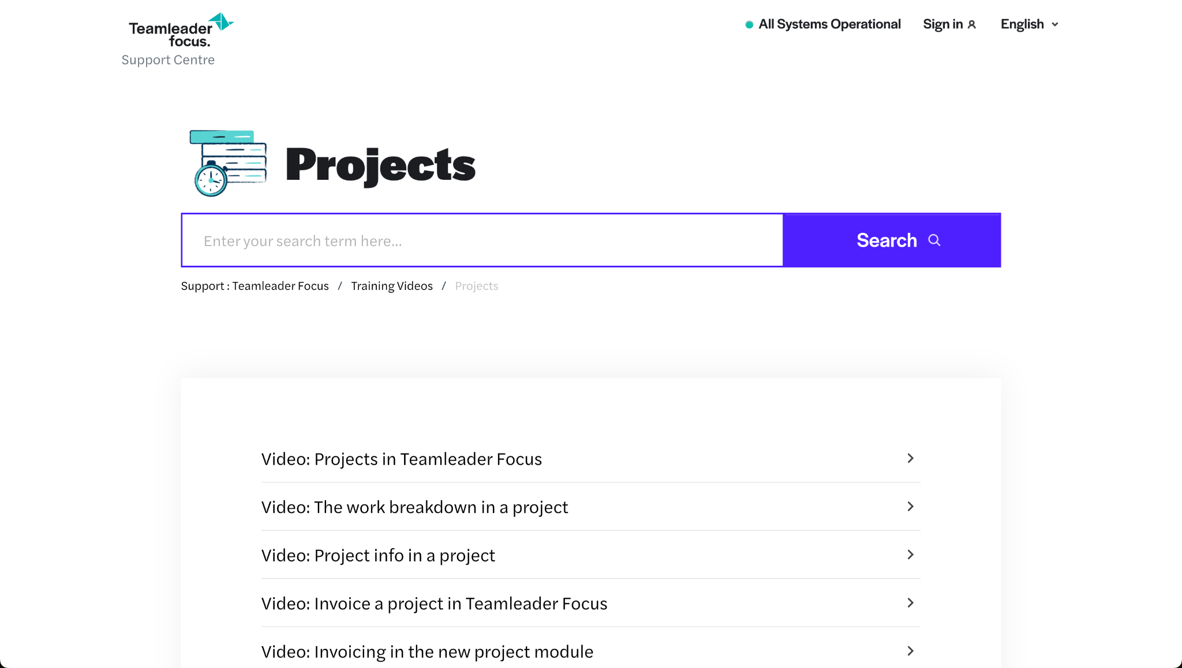
CHECKLIST
ADDITIONAL PREPARATION - TRAINING VIDEOS
Support Centre > Training videos > Projects.
Notes:
Finally, I would like to refer to our training videos. In fact, quite a few webinars and videos have already been made about the new project module. If you want to know what the invoicing options are or what exactly the project info can tell you, be sure to take a look there.
Soon you will also find this recording on the support centre, along with the checklist you can use to ensure a smooth migration.

Slide 26
CONCLUSION
EXAMINATE
EVALUATE
COMMUNICATE
Prepare yourself and your team well for the migration so that you can fully enjoy your start with new projects.
Notes:
The conclusion of this webinar is clear: examinate, evaluate and communicate. The change to the new project module will go smoothly if you test, compare and inform your team about the changes.
With the comparison between the old and new project modules in mind, you will be ready to prepare yourself and your team well for the migration so that you can then fully enjoy your start within the new Teamleader Focus projects.

Slide 27
END OF WEBINAR
Migrate to the new projects
Notes:
Thanks for your attention and hope to see you next time!

